Slide 1
NT219- Cryptography
Introduction to Cryptology
PhD. Ngoc-Tu Nguyen
tunn@uit.edu.vn

Slide 2
Outline
Introduction to cryptography courses
Why cryptology?
Syllabus;
Guide for reading textbooks and library;
Policy and course assessment;
Projects;
Labs and guides

Slide 3
Why cryptology?
Cryptology= Cryptography + Cryptanalysis
“Secret writing”
Try to analysis the codes
to reveal secrets
Information security

Slide 4








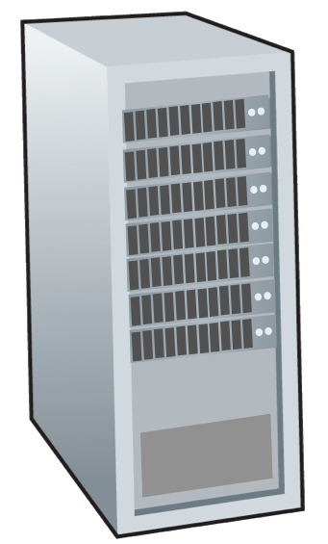







Motivations
Network devices:
End devices
Intermediate devices
mobile network
national or global ISP
Communication links
fiber, copper, radio
transmission rate: bandwidth
local or regional ISP
Internet
home network
content
provider
network
Network protocols
How to secure storage and exchange data?
datacenter
network
enterprise
network
Send?
Receiver?
Storage?

Slide 5
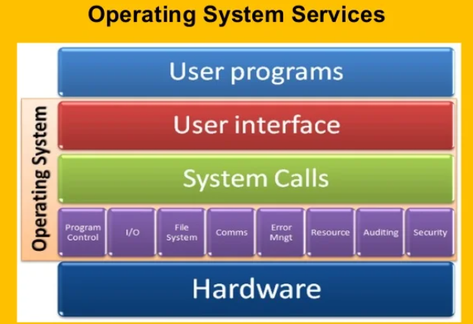
Motivations
Data Protection
mobile network
national or global ISP
Data
Transmission state
Process state
Storage state
local or regional ISP
Internet
home network
content
provider
network
datacenter
network
enterprise
network
Network or host?

Slide 6
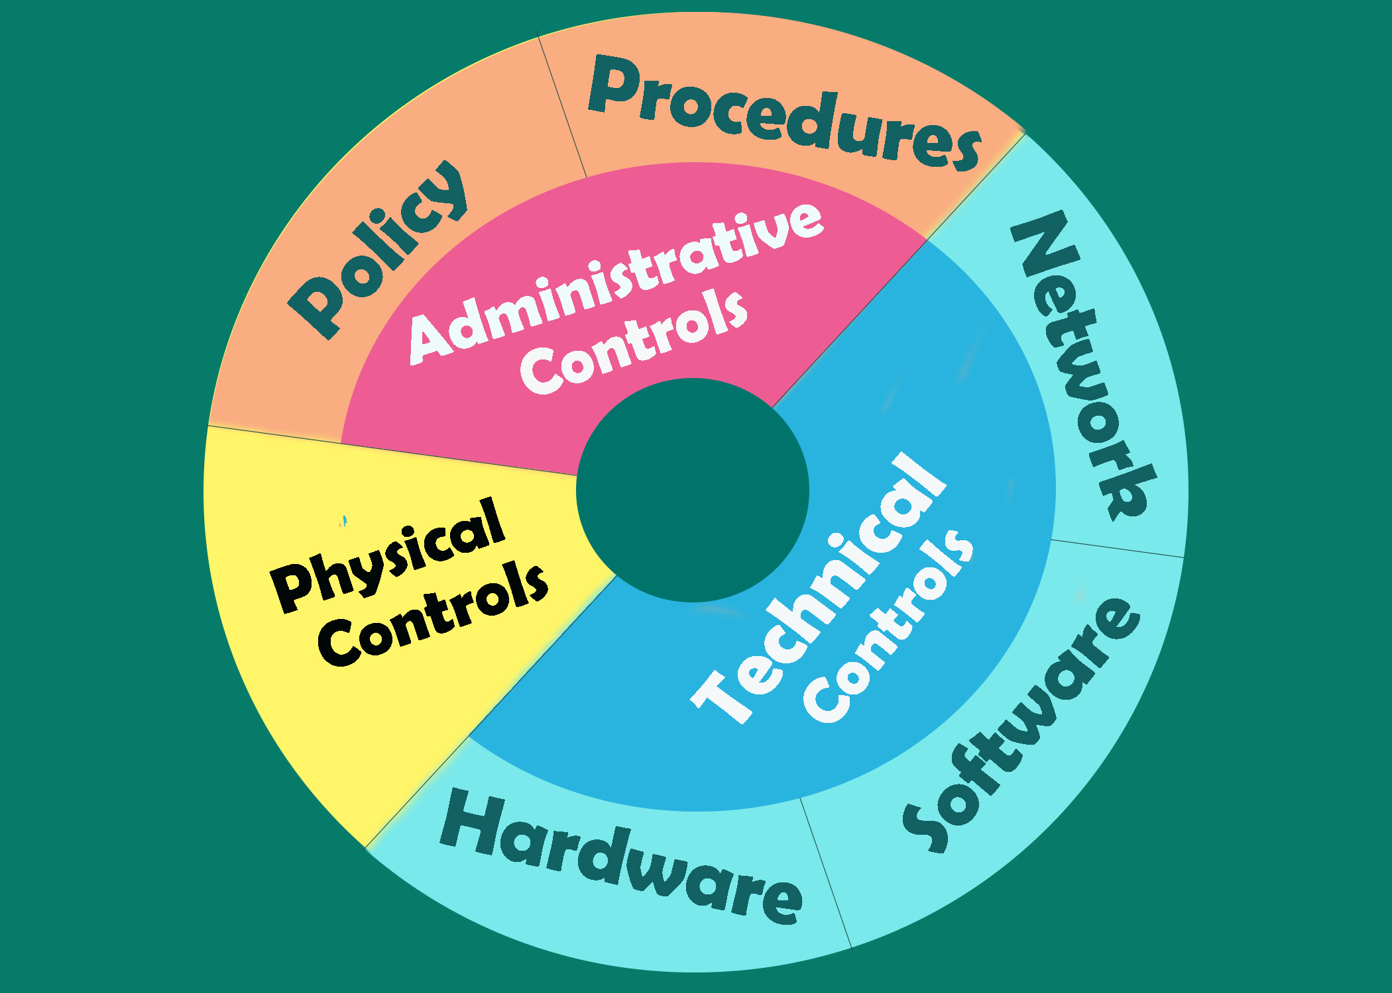
Motivations
Defense in depth:
assets
Notes:
Defence in depth:

Slide 7
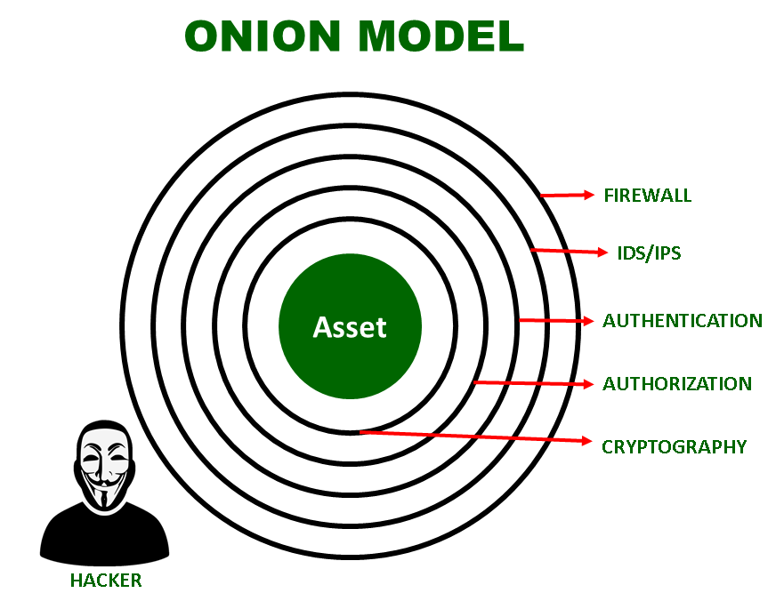
Motivations
Technical solutions
Defense in depth:
Host or network?
☞ https://owasp.org/www-project-top-ten/
Internal threats
External threats
Partners
Example solutions
adversary
Notes:
Defence in depth:

Slide 8
What is cryptograph?
Cryptology= Cryptography + Cryptanalysis
Goals
What?
Cipher systems
- Sysmmetric (AES)
- Asymmetric (RSA, ECC, CRYSTALS-KYBER)
Confidentiality
Privacy
Integrity
Hash functions
Message authentication code (MAC)
Digital signature (digital certificate)
Authentication
Non-repudiation (Accountability)
Availability

Slide 9
Motivations
Protect digital assets?
Data and software
What is data?
Any object that can be processed or executed by a computer
Three states of data
Transmission state
Storage state
Processing state
Data vs. information security
Hardware and devices
Reputation

Slide 10
Motivations
Security goals?
Confidentiality
including data in transmission and storage states
Data integrity
including data in transmission and storage state
Non-repudiation
Authentication
All nodes in network, users, …
Privacy
Availability

Slide 11
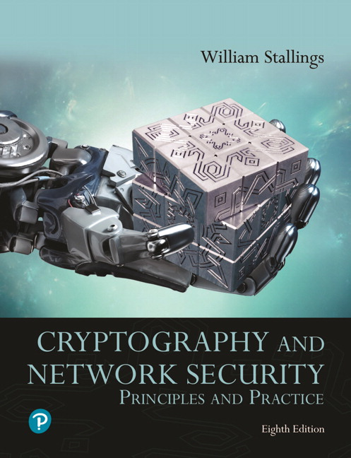
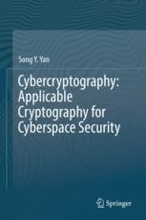
Textbooks and References
Text books
[1] Stallings, W. (2019). Cryptography and network security : principles and practice (8th): Pearson Education
[2] Yan, S. Y.(2019). Cybercryptography: Applicable Cryptography for Cyberspace Security: Springer.

Slide 12
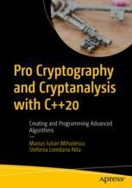
Textbooks and References
Reference books for labs
[3] Mihailescu, M. I., & Nita, S. L. (2021). Pro cryptography and cryptanalysis with C++20: creating and programming advanced algorithms: Apress.

Slide 13
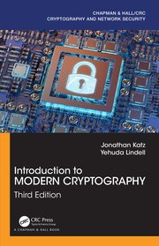
Textbooks and References
Other references
[4] Katz, J., & Lindell, Y. (2020). Introduction to modern cryptography (3rd): CRC press.

Slide 14
Syllabus
Week 1. Introduction to the course
Week 2. Introduction to cryptography
Cryptography overview;
Some terminologies;
Classical cryptography
Week 3,4. Symmetric cryptography
Overview;
Stream cipher (chaotic maps)
Block cipher (DES, AES and mode of operations)
Introduction to some other modern cipher systems

Slide 15
Syllabus
Week 5. Project reports (first time)
Week 6,7,8. Asymmetric cryptography
Overview;
Cryptosystems are bases on factoring problems;
Cryptosystems are bases on discrete logarithm problems;
Elliptic curve cryptosystems
Week 9,10. Hash function and data authentication
Hash functions;
HMAC;
Data integrity;

Slide 16
Syllabus
Week 11. Digital signature
Digital signature
Application
Week 12,13. Applied cryptography
Authentication (Kerberos);
Network security (IPSec; SSL/TLS; SSH);
Database security;
Week 14. Post-quantum Cryptography/ Blockchain network;
Week 15. Final project report;

Slide 17
Guide for reading textbooks and libraries
Textbooks
[1] Stallings, W. (2019). Cryptography and network security : principles and practice (8th): Pearson Education.
[2] Yan, S. Y.(2019). Cybercryptography: Applicable Cryptography for Cyberspace Security: Springer.
Labs
[3] Mihailescu, M. I., & Nita, S. L. (2021). Pro cryptography and cryptanalysis with C++20: creating and programming advanced algorithms: Apress.
References
[4] Katz, J., & Lindell, Y. (2020). Introduction to modern cryptography (3rd): CRC press.

Slide 18
Guide for reading textbooks and libraries
1. CrypTool 2: https://www.cryptool.org/en/ct2/
2. Crypto++ Library 8.7: https://www.cryptopp.com/
3. Openssl 3.1 https://github.com/openssl/openssl
3. C++ Programing Language: Visual Studio Code & MSYS2
https://www.msys2.org/;
https://code.visualstudio.com/
4. Windows and Linux OS:
Windows 10, 11; Ubuntu 20 or Kali Linux
https://www.kali.org/;
https://releases.ubuntu.com/20.04/

Slide 19
Policy and course assessment
1.Attendants: >= 80%;
2. Assignments: Must complete (Bonus points);
3. Labs: Must complete (home and classroom);
4. CTF: Bonus points
5. Assessments:
+) Process assessment (Project) 30%:
15 (Final present) + 15 (final report);
+) Lab assessment: 20%;
+) Final assessment: 50%
Closed-book wiring exam or oral exam

Slide 20
Projects
1.Project titles: Chosen your-self
2. References and literature survey:
Management papers (Endnote)
Search and download papers
4. Some other guides
- Determine Topic
- Problem analysis
- Solution architecture
- Implementation and testing
- Application deployment

Slide 21
Projects
6. References
- IEEE
- ISI/Scopus
- webofscience
- Scholar
- sci-hub.ru

Slide 22
Labs
Lab guides
- Dual boot
- Setup for windows
- Setup for Linux

Slide 23
Class communication
MS Team classroom
Class code: check your email (studentID@ms.uit.edu.vn)
My email: tunn@uit.edu.vn
Room: E8.6 (Thursday)

